Slide 1
EECS 12 Project 2: Python Library Turtle
Udit Kaushik
Summer Session 1
EECS 12

Slide 2
Overview of Turtle
Turtle is an inbuilt Python library that allows the user to create drawings in a graphics canvas. It is a very simple way for programmers to create programs with graphical interfaces. The nice part about turtle is that its nearly 100% compatible with previous versions up to 2.5. Also, it uses tkinter for the underlying graphics.
Notes:
How presentation will benefit audience: Adult learners are more interested in a subject if they know how or why it is important to them.
Presenter’s level of expertise in the subject: Briefly state your credentials in this area, or explain why participants should listen to you.

Slide 3
Classes
Class 1: Turtle Motion
Class 2: Turtle Canvas
Class 3: Turtle Appearance
Class 4: Turtle Inputs
Class 5: Special Turtle Methods
Notes:
Lesson descriptions should be brief.

Slide 4
Basic Class Outline
To use Turtle classes, all you have to do is use the following code:
from turtle import *
Notes:
Example objectives
At the end of this lesson, you will be able to:
Save files to the team Web server.
Move files to different locations on the team Web server.
Share files on the team Web server.

Slide 5
Class 1: Turtle Motion
Using the motion class of turtle is very much like appending a list.
For example:
Appending a list requires you to ensure that the list is defined and then to use an append statement.
>>> new_ list = []
>>> new_list.append( 10)
>>> print(new_list)
>>> 10
Similarly:
Turtle simply needs you to specify the directional command of the cursor.
>>> from turtle import *
>>> orign = turtle.position()
>>> origin
(0,0)
>>> origin.forward(25)
>>> origin
(25, 0)
>>> origin.backward(25)
>>> origin
(0, 0)

Slide 6
Turtle Motion Attributes
Distance: (float) movement for specific distances
Coordinates: (pair of coordinates) used to find specific distances and establish starting and ending points
Input: (float) used to establish specific coordinates

Slide 7
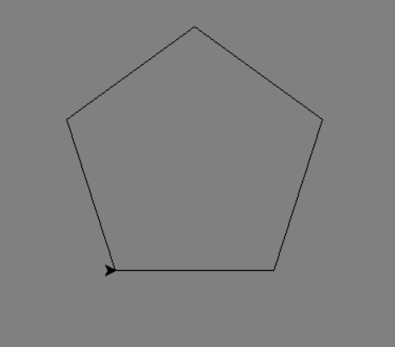
Turtle Motion Example
>>> import turtle
>>> origin = turtle.position()
>>> origin.forward(25)
>>> origin.backward(25)
>>> origin.right(50)
>>> origin.left(50)
>>> point = turtle.setposition(10, 10)
>>> point
(10,10)
>>> point = turtle.home() >>> point
(0,0)
>>> point.setheading()
(0,0)
>>> circle = turtle.circle(10, 15, 20)
>>> origin.undo()
>>> tutle.speed(‘fast’)
>>> x_cord = turtle.setx(10)
>>> y_cord = turtle.sety(10)

Slide 8
Class 2: Turtle Canvas
The Turtle Canvas Class is an extremely versatile class because it allows for quick and easy accessibility of the canvas. The canvas is the working station of the turtle graphics window and includes everything from color to cartesian coordinate systems.
It is implemented the same way as the Turtle Motion Class:
>>> import turtle
>>> canvas = turtle.position() #initializes the canvas at point (0,0); no input is read as (0,0)
>>> canvas.stamp() #creates a turtle stamp
>>> canvas.clearstamp() #removes the turtle stamp

Slide 9
Turtle Canvas Attributes
Coordinates = (float) initialize and establish beginning and ends of drawings
Speed = (string/fast) establishes the speed at which cursor moves

Slide 10
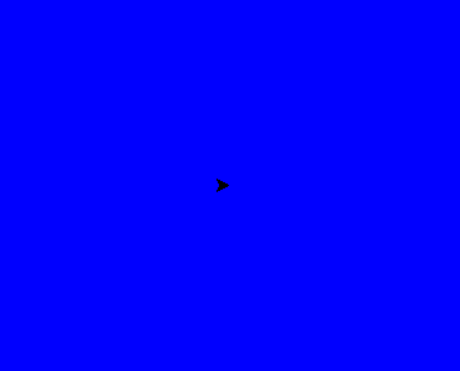
Turtle Canvas Example
>>> import turtle
>>> canvas = turtle.position()
>>> canvas.stamp()
>>> canvas.clearstamp()
>>> canvas.position()
>>> canvas
(0, 0)
>>> canvas.xcor()
0.00
>>> canvas.ycor()
0.00
>>> canvas.heading()
>>> canvas.color(‘blue’)
>>> canvas.filling()
True
>>> canvas.reset()
>>> canvas.clear()
>>> canvas.showturtle()
def draw_shape():
print("Click the graphics screen to exit out")
window = turtle.Screen()
window.bgcolor("blue")
window.exitonclick()
draw_shape()

Slide 11
Class 3: Turtle Appearance
Since the turtle library is a fun and interactive part of the python language, it, also, allows for the user to change the cursor! The cursor can change from anything like a triangle or an arrow to an actual turtle. The cursor class also includes colors to accommodate the cursor styling with.
It is implemented in the same way as the Turtle Motion Class:
For example,
>>> import turtle
>>> cursor = turtle.shape(‘triangle’)
>>> cursor.resizemode(10, 20) #image drawn by the cursor accommodates this restriction

Slide 12
Turtle Appearance Attributes
Shape = (string) changes shape of the cursor
Boundaries = (float) changes the boundaries of a shape and the cursor

Slide 13
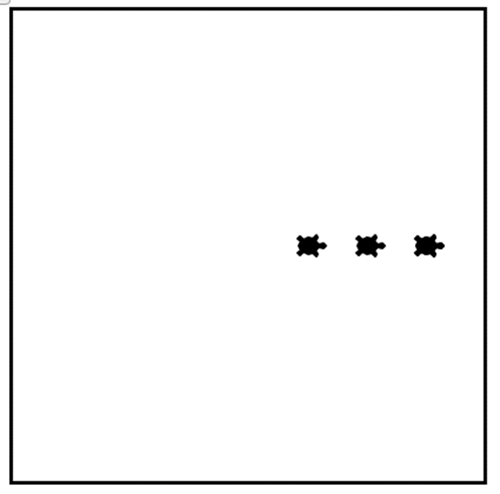
Turtle Appearance Example
>>> import turtle
>>> cursor = turtle.shape(‘triangle’)
>>> cursor.resizemode(10, 20)
>>> shape = turtle.circle(5, 10, 20)
>>> shape.rmode(1, 2, 4)
>>> shape.shapesize(3)
>>> cursor.turtlesize(5)

Slide 14
Class 4: Turtle Inputs
The Turtle library allows multiple ways for a user to input values when a function is run. Instead of the conventional input() call, the library allows for mouse clicks, and the pressing/release of a key.
It is implemented in the same way as the Turtle Motion Class:
>>> import turtle
>>> user_in = turtle.onclicks()
>>> user_in = turtle.release()
>>> user_in = turtle.ondrag()

Slide 15
Turtle Inputs Attributes
User_ in = mouse click
User_in = release of key
User_in = pressing a key

Slide 16
Turtle Input Examples
>>> import turtle
>>> user_in = turtle.onclicks()
>>> user_in = turtle.release()
>>> user_in = turtle.ondrag()

Slide 17
Class 5: Special Turtle Methods
The Special Turtle methods is a class of methods that establishes faster ways to do tasks that are reoccurring when programming in Turtle. It’s basically a class of shortcuts that simplify coding for the programmer and makes the code more readable.
It is implemented in the same way as the Turtle Motion Class:
>>> import turtle
>>> circle = circle(5, 10, 20)
>>> poly = circle.begin_poly(‘circle’)
>>> poly.end_poly()

Slide 18
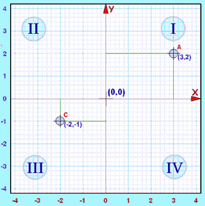
Special Turtle Methods Attributes
Coordinates = (float) Begins the function from the given coordinate

Slide 19
Special Turtle Methods Example
>>> import turtle
>>> circle = circle(5, 10, 20)
>>> poly = circle.begin_poly(‘circle’)
>>> poly.end_poly()
>>> poly.get_poly()
True
>>> poly.clone()
>>> poly.getturtle() #gets the cursor direction
>>> poly.getscreen()

Slide 20
Turtle Examples
Shapes Example:
https://docs.google.com/a/uci.edu/document/d/1zdkPJ0FynoyVhzm9DvcGLSR7_XdykKFBKIUFJCxHBng/edit?usp=sharing
*Clock Example :
https://docs.google.com/a/uci.edu/document/d/1zdkPJ0FynoyVhzm9DvcGLSR7_XdykKFBKIUFJCxHBng/edit?usp=sharing
*Used online code for clock example

Slide 21
Conclusion
Python is a powerful language that comes equipped with many powerful libraries, but what makes Turtle stand out is its unique casualness. It is not as intensive as other libraries and is very simply to use with extremely good results at the end of a program. With customizable cursors and colors, Turtle is definitely a great way to learn about the graphics aspect of programming.

